Slide 1
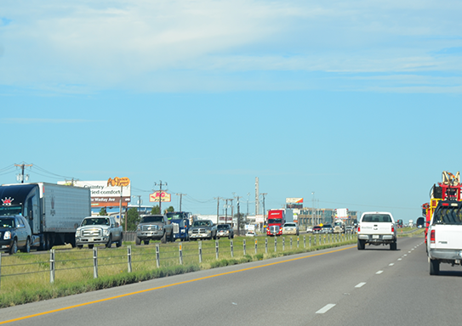
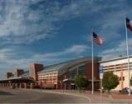
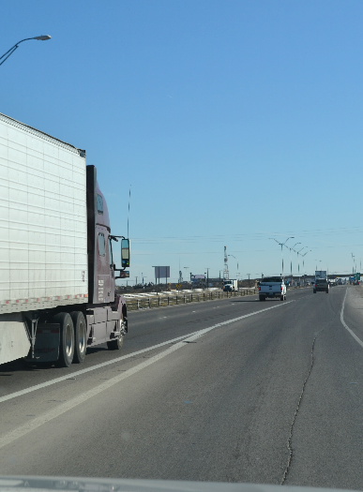
I-20 Permian Basin Corridor Study
PBMPO Policy Board
December 19, 2016
Notes:
Photos: TxDOT, TxDOT, PBMPO, PBMPO

Slide 2
Meeting Overview
Public Involvement
3-8
Segment Prioritization
9-17
Corridor Implementation Plan
18
Looking Ahead to 2040
19-25
Next Steps
26

Slide 3
Stakeholder Workgroup
Stakeholder Workgroup consists of representatives from:
Local Businesses: Halliburton, Standard Sales, Mazda VW of Midland, and LPZ Enterprises
City of Odessa and City of Midland
Ector and Midland County
EZ Rider
Permian Basin Metropolitan Planning Organization (MPO)

Slide 4
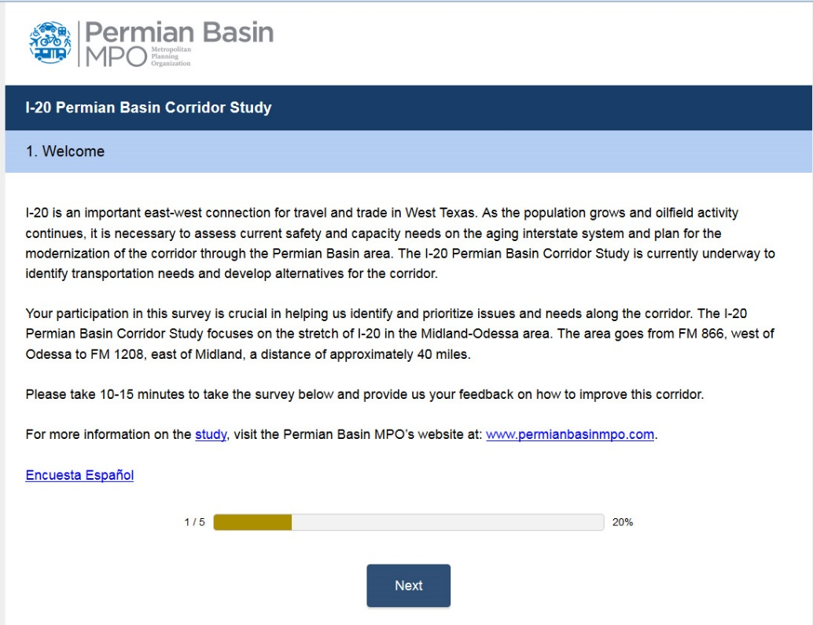
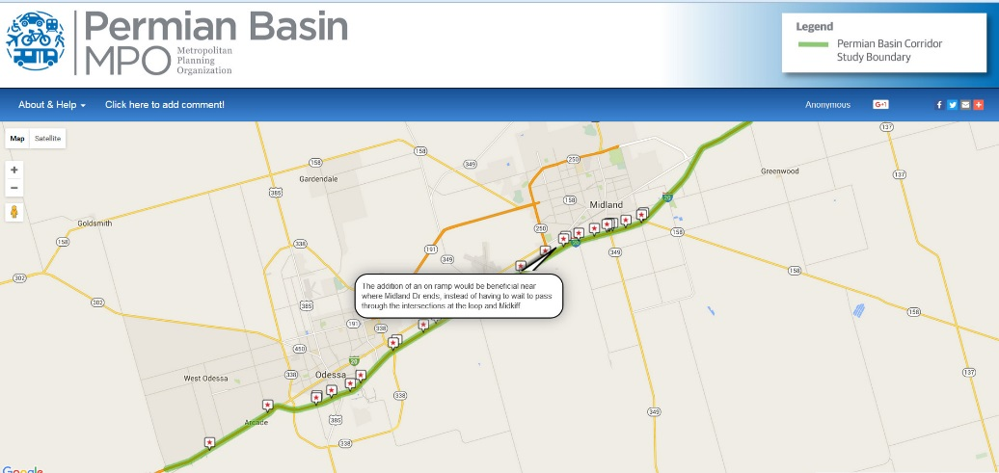
Travel Survey
Online public survey tool active for three months
Uses SurveyMonkey
English and Spanish versions
Includes 10 questions and link to interactive map
Received 605 survey responses
Notes:
The travel survey has solicited an impressive number of responses, we will now go over some of the stats on the survey and responses.
NOTE – CH2M will update this prior to the meeting.

Slide 5
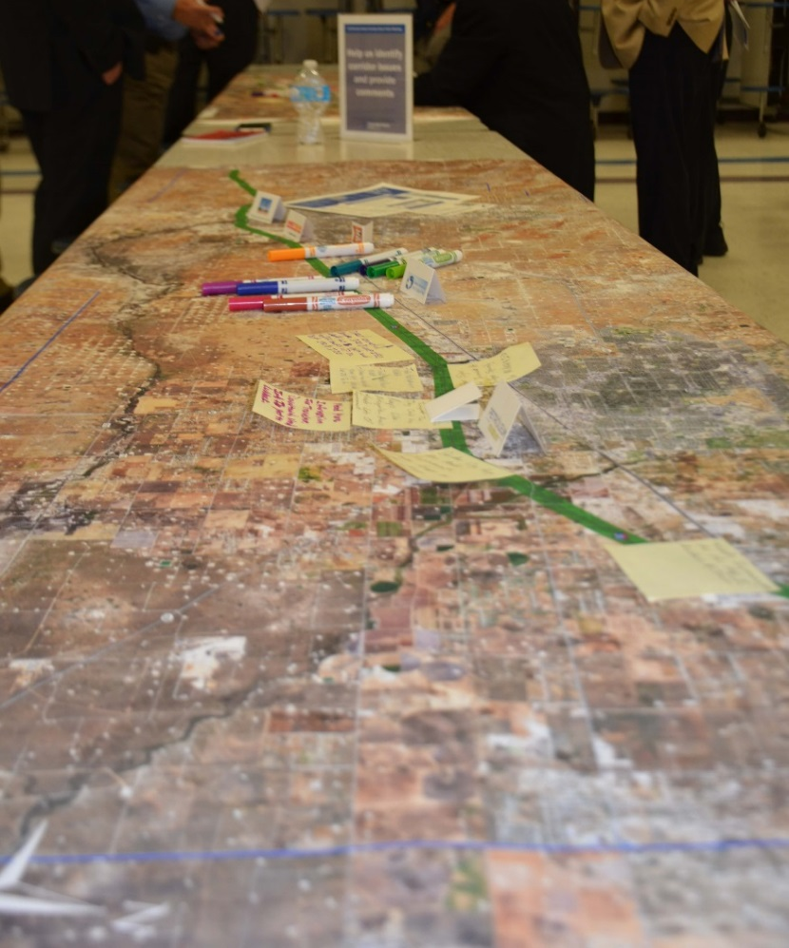
Public Meeting Summary
Two Public Meetings Held
Sept 27th in Odessa
Sept 29th in Midland
Received Additional Feedback
Comment cards
Post-it notes
Notes on maps
Notes:
The travel survey has solicited an impressive number of responses, we will now go over some of the stats on the survey and responses.
NOTE – CH2M will update this prior to the meeting.

Slide 6
Comments Received – Topic Areas
When all the comments were broken out by unique issues or areas along the corridor – there were a total of 655 unique comments
Top topic areas:
Ramp issues (improve, add, or extend) generated 147 comments.
Notes:
The travel survey has solicited an impressive number of responses, we will now go over some of the stats on the survey and responses.
NOTE – CH2M will update this prior to the meeting.

Slide 7
Comments Received – by Segment
Includes comments that could be assigned to a segment
Number of comments per segment
Notes:
The travel survey has solicited an impressive number of responses, we will now go over some of the stats on the survey and responses.
NOTE – CH2M will update this prior to the meeting.

Slide 8
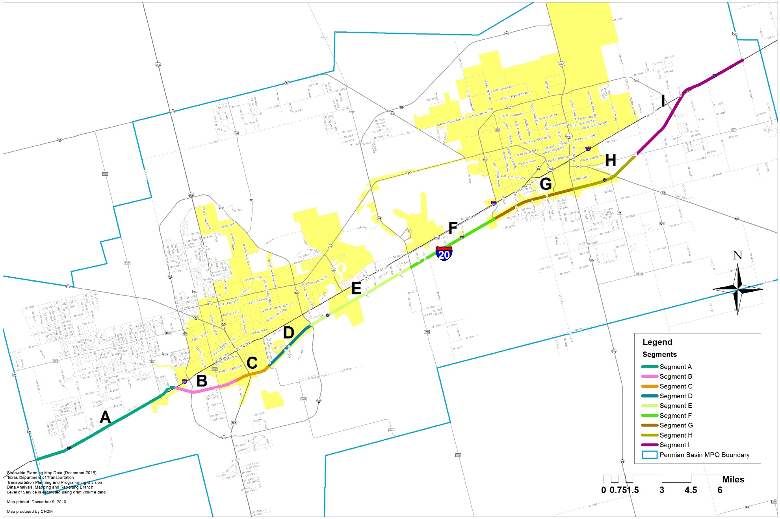
Segments
Segment | From | To
Segment A | FM 866 | Business 20
Segment B | Business 20 | Crane
Segment C | Crane | FM 3503
Segment D | FM 3503 | Loop 338
Segment E | Loop 338 | FM 1788
Segment F | FM 1788 | West Loop 250
Segment G | West Loop 250 | SH 349
Segment H | SH 349 | FM 307
Segment I | FM 307 | FM 1208

Slide 9
Segment Prioritization
Previous Research
Frontage Road Conversion Analysis for Existing I-20 Frontage Roads (2014).
I-20 Corridor Study (1999).
Current/Forecasted Condition Data
Traffic Volumes/ LOS Analysis
Corridor Crash Data
Pavement Condition Data
Design Deficiencies per TxDOT standards
Segment Prioritization for Improvement Alternatives
Needs Identification
Stakeholder Working Group (Local transportation challenges: safety, congestion, mobility, weather, capacity, etc.)
Corridor Vision/ Public Input
September 2016 Public Meetings
Travel Survey
Notes:
Validation of initial observations
Continued analysis of current and forecasted conditions
Traffic data
Prop 1 Funding
Public input and comment

Slide 10
Segment Summary – By The Numbers
Items colored red indicate the poorest performing segments within that criteria.

Slide 11
Segment Summary Rank/Score
Each column features segments ranked 1-9 for each criteria where 1 represents the best performing and 9 represents the poorest performing segment.
*TxDOT is currently studying Segment F for improvements and consequently has been eliminated from consideration. As a result, Segment E becomes the fourth highest ranked segment.

Slide 12
Stakeholder Workgroup Recommendation
Recommended Segments for Improvements:
Segment C (East of FM 1882 Interchange to Grandview)
Segment E (East of Loop 338 to East of FM 1788)
Segment G (West of West Loop 250 to SH 349)
Segment H (SH 349 to FM 307)

Slide 13
Recommended Segments for Improvement Alternatives

Slide 14
Segment C – East of FM 1882 Interchange to Grandview – 3.3 miles

Slide 15
Segment E – East of Loop 338 to East of FM 1788 – 6.2 miles

Slide 16
Segment G – West of West Loop 250 to SH 349 – 5 miles

Slide 17
Segment H – SH 349 to FM 307 – 3.8 miles

Slide 18
Corridor Implementation Plan
Develop an Implementation Plan, which is a roadmap to phased corridor improvements
Identifies corridor needs while providing circulation and access with minimal disruption to adjacent land uses
Includes a conceptual program of improvement projects consisting of near, mid, and long term needs, each with its own scope and cost estimate
Development of individual projects will be determined by the MPO Policy Board by adoption of projects in the Metropolitan Transportation Plan

Slide 19
Looking Ahead to 2040: Corridor Typical Section (ultimate)
Corridor Typical Section (ultimate) will meet 2040 traffic demand and includes:
4 to 6 mainlanes (depending on location) with one-way frontage roads
TxDOT commits to construct Texas Turnarounds at interchanges and additional crossovers as needed to provide adequate circulation
Local municipalities are interested in planning backage road improvements
The conversion of frontage roads will happen at the same time as ultimate corridor improvements and will be done in logical segments, not all at once
During detailed design, stakeholders and the public will be engaged in specific capacity improvement projects

Slide 20
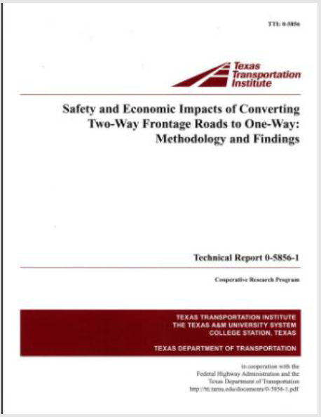
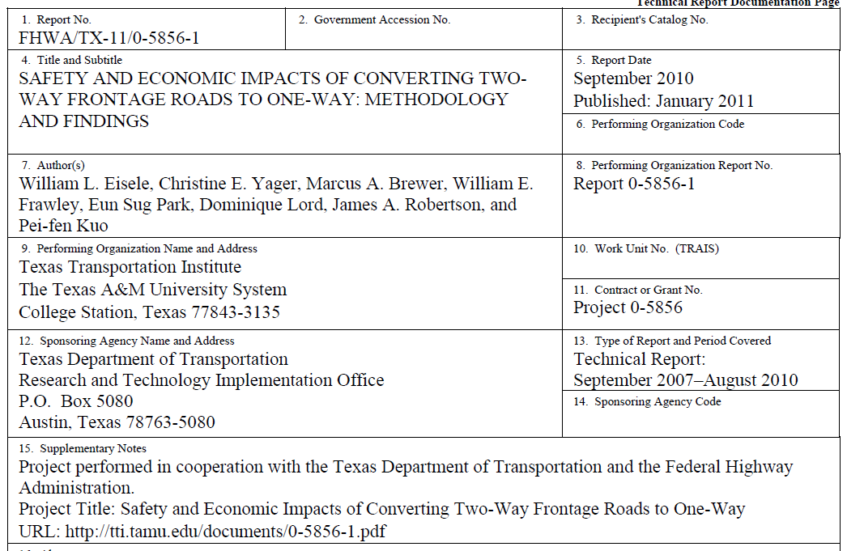
Impacts of frontage road conversions

Slide 21
Safety impacts of frontage road conversions
Two-way to one-way frontage road conversions improved safety by:
Reducing serious head-on and angle crashes by
Reducing fatal and injury crashes by
83 - 94%
57%
Reducing intersection crashes by
Reduces serious rear-end crashes by
73%
77 - 85%
Eisele, William, Christine Yager, Marcus Brewer, William Frawley, Eun Sug Park, Dominique Lord, James Robertson, and Pei-fen Kuo, 2011. Safety and Economic Impacts of Converting Two-way Frontage Roads to One-way: Methodology and Findings. Texas Transportation Institute (TTI) at Texas A&M University. Sponsored by FHWA.

Slide 22
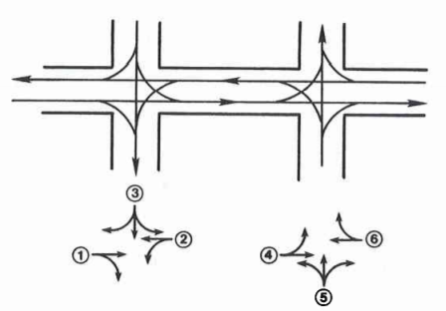
Safety impacts of frontage road conversions
Reduction in number of conflict points
Two-way operation
One-way operation
FRONTAGE RD
FRONTAGE RD
FRONTAGE RD
FRONTAGE RD
CROSS STREET
CROSS STREET
32 Conflict points
16 Basic Movements
10
6
Conflict points
Basic Movements
Woods, Donald L., Myung-Soon Chang, and Carlton Allen, 1983. Operational and Safety Analysis of Two-Way and One-way Frontage Roads. Texas Transportation Institute (TTI) at Texas A&M University. Sponsored by FHWA.

Slide 23
Business impacts of frontage road conversions
Gross Sales Data
Appraisal Data
No substantial negative impacts to businesses three years after frontage road conversion
No apparent negative effects on appraisal values along conversion sites in the long-term
Employment Data
Eisele, William, Christine Yager, Marcus Brewer, William Frawley, Eun Sug Park, Dominique Lord, James Robertson, and Pei-fen Kuo, 2011. Safety and Economic Impacts of Converting Two-way Frontage Roads to One-way: Methodology and Findings. Texas Transportation Institute (TTI) at Texas A&M University. Sponsored by FHWA.

Slide 24
Business impacts of frontage road conversions
Surveys of business owners/ managers and customers
Prior to conversion, customers, owners, and managers ranked the following
Customer Service
Product Quality
Product Price
Distance to travel
Accessibility to Store
Eisele, William, Christine Yager, Marcus Brewer, William Frawley, Eun Sug Park, Dominique Lord, James Robertson, and Pei-fen Kuo, 2011. Safety and Economic Impacts of Converting Two-way Frontage Roads to One-way: Methodology and Findings. Texas Transportation Institute (TTI) at Texas A&M University. Sponsored by FHWA.

Slide 25
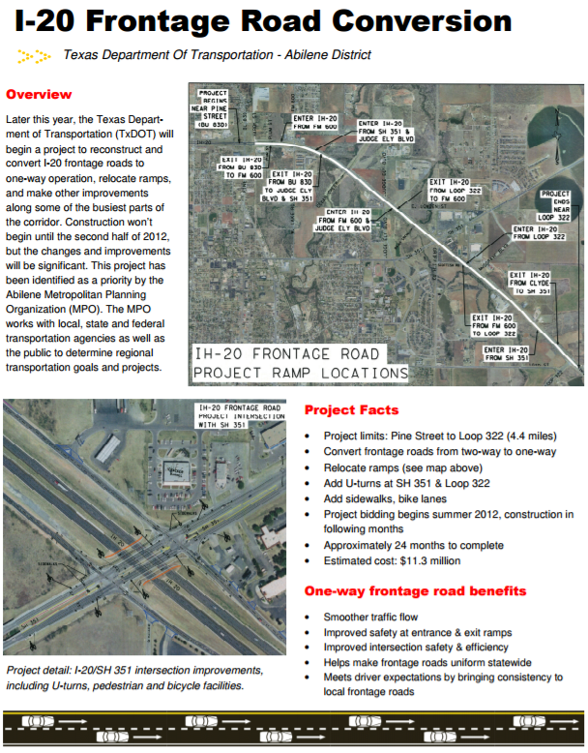
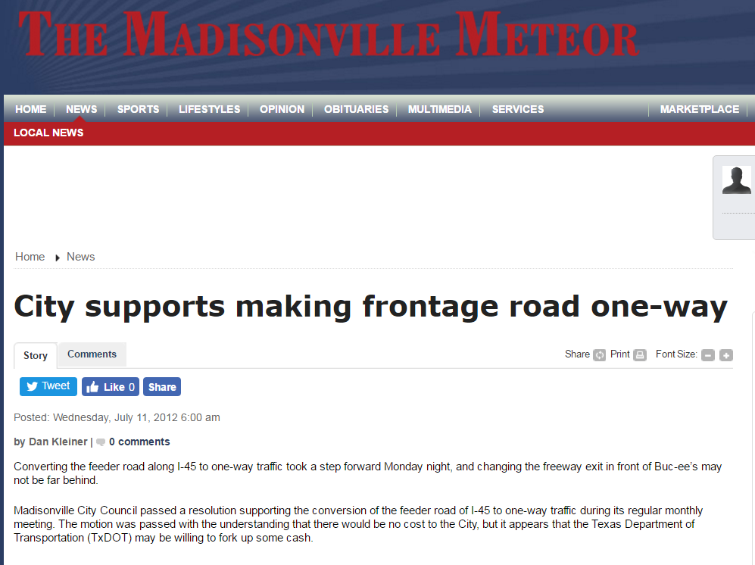
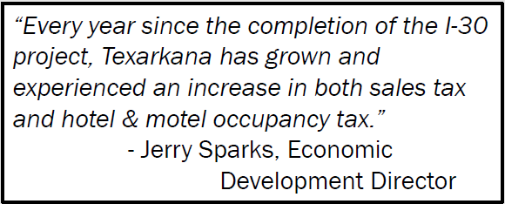
Similar Frontage Road Conversion Projects
Other interstates where frontage roads have been converted to one-way include:
I-30 in Texarkana
I-20 in Abilene
I-45 near Madisonville
I-35 near Kyle/San Marcos
http://www.madisonvillemeteor.com/news/article_2c19fc32-cae7-11e1-aeeb-0019bb2963f4.html
https://ftp.dot.state.tx.us/pub/txdot-info/abl/i20/i20_brochure.pdf
http://static.tti.tamu.edu/conferences/tsc16/presentations/traffic-ops-2/simmons-dupree%20.pdf

Slide 26
Next steps
Policy Board Consideration of Recommendations (January 2017)
Preliminary Design of Recommended Segments (2017)
Corridor Implementation Plan (2017)
Future Stakeholder Workgroup Involvement (TBD)

Slide 27
Thank you!
Cameron Walker, AICP
Executive Director
Permian Basin MPO
cwalker@permianbasinmpo.com
Roger Beall, PE
Corridor Planning Manager
TxDOT
Roger.Beall@txdot.gov
Will Barresi, PE
Project Manager
CH2M
Will.Barresi@ch2m.com
Iconography created by Anuar Zhumaev, Stephanie Wauters, Firman Suci Ananda, Creative Outlet, and David via the Noun Project.

